Slide 1


Illustrations used in the book

Slide 2
























Create
Store
Collaborate
Analyse
Word
Excel
OneDrive
SharePoint
Outlook
Bookings
Power BI
Viva Insights
PowerPoint
OneNote
Automate
Lists
Stream
Execute
Teams
Shifts
Sway
Forms
Power
Automate
Power
Apps
Visio
Whiteboard
To Do
Planner
Yammer
Delve
Notes:
Please note: all icons are in SVG format.

Slide 3


14000+ features
are available
How many do
YOU use?

Slide 4
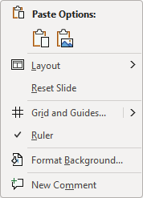



IT
Needs
Solution
Users
Solutions
Features
Needs
Users
Needs
Features

Slide 5
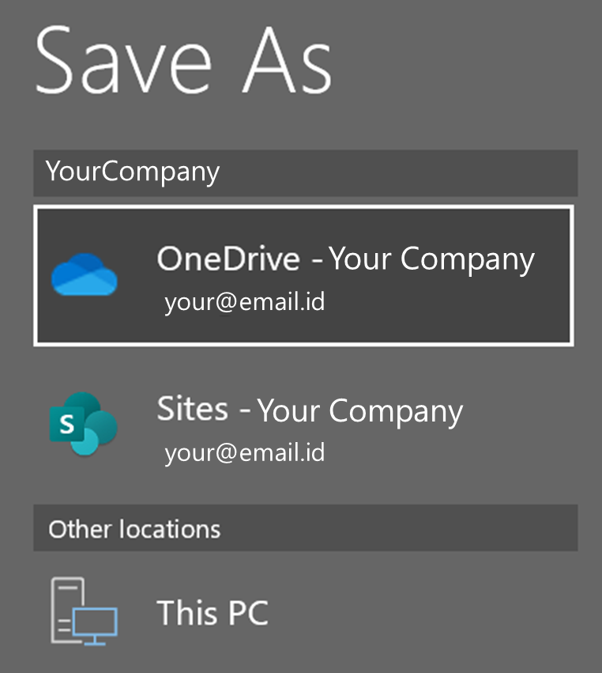















Notes:
Using drawing ink with animation.

Slide 6



Useless Repetition | Hands vs. Brain | I am helping the app

Slide 7












Slide 8
Inefficient work
Wastage of time
Shortage of time
No time to learn
Efficient work
Save time
Learn more

Slide 9
Bad data
Clean up
Analysis

Slide 10
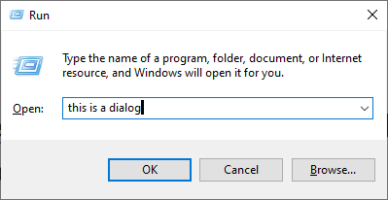





Slide 11
Document
Section 1
Page 1
Page 2
Section 2
Page 4
Page 5
Page 6
Section 3
Page 7
Page 8
Page 9
Page …
Page 3

Slide 12
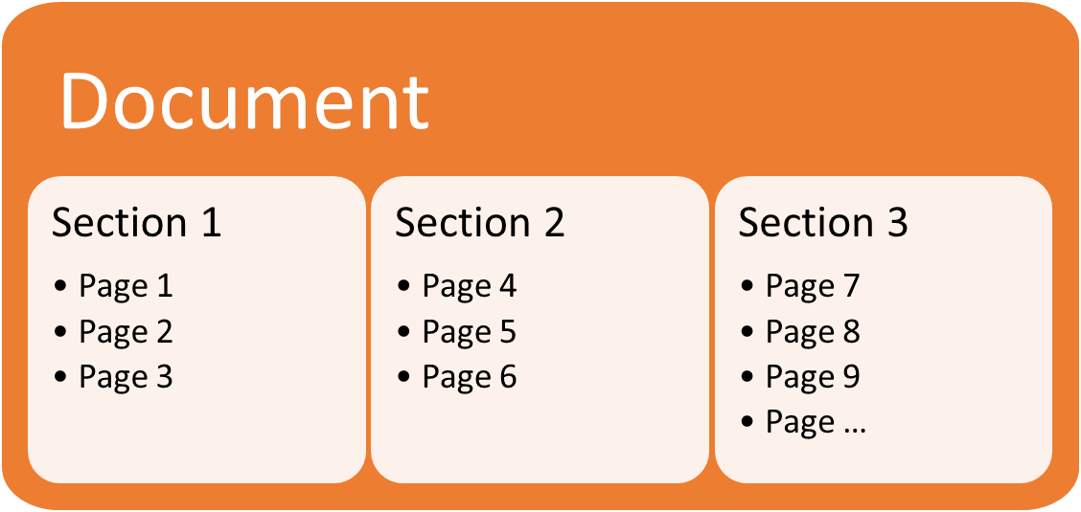
Document
Section 1
  Page 1
  Page 2
  Page 3
Section 2
  Page 4
  Page 5
  Page 6
Section 3
  Page 7
  Page 8
  Page 9
  Page …

Slide 14


Right Drag Drop
from Inbox
to Tasks folder icon

Slide 15


Types of Teamwork
 | Simple - Single Task | Multiple Related Tasks
Tasks | One Task | Project Plan
Duration | Short | Long
People | Few | Project Team
Objective | Finish Task | Complete the project
Example | Create Customer Proposal | Product Launch

Slide 16
Work …
HR | Finalize new Work from Home policy
Finance | Create budget for next quarter
Marketing | Design ad campaign for new product
Procurement | Get quotations for laptop purchase from 20 vendors
Manufacturing | Plan next maintenance cycle
Quality | Compare quality improvement over last 3 months

Slide 17


























Phone Calls | Chats | Video Calls | Files | Meetings | Emails | Live Events

Slide 18

Phone Calls | Chats | Video Calls | Files | Meetings | Emails | Live Events
Group Calls Voicemail Forward Hold Dial Out PSTN integration | Archival Group Chat External OneDrive file sharing Whiteboard Meetings as chat | 49 videos Gallery Recording Chat Polls Together Mode Standout Mode | Auto Sharing Edit together Auto Save Auto Version Audit Trail DLP Compliance | Before During After Auto Transcript Breakout Rooms 300+ Apps | Minimize email usage Manage Projects Use Channels Shared Task List Activity Feed | 20,000 pax Internal or External No special app No extra cost Registration Live Transcript

Slide 19

OneDrive Benefits
Auto Save
All devices
Always one copy
Forwarded links don’t work
Auto Versions
Edit Together
Send links
Not attachments
Auto Sync
No more Copy Paste
Browser Editing
Can change after sending
1000 GB storage space

Slide 20
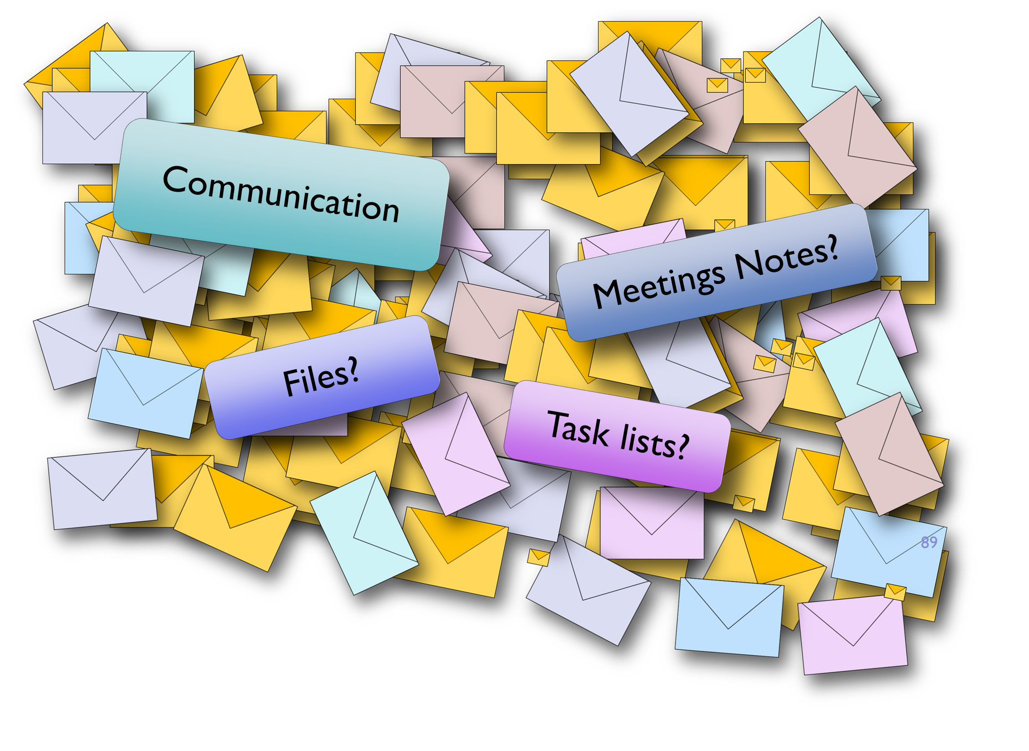


Slide 21
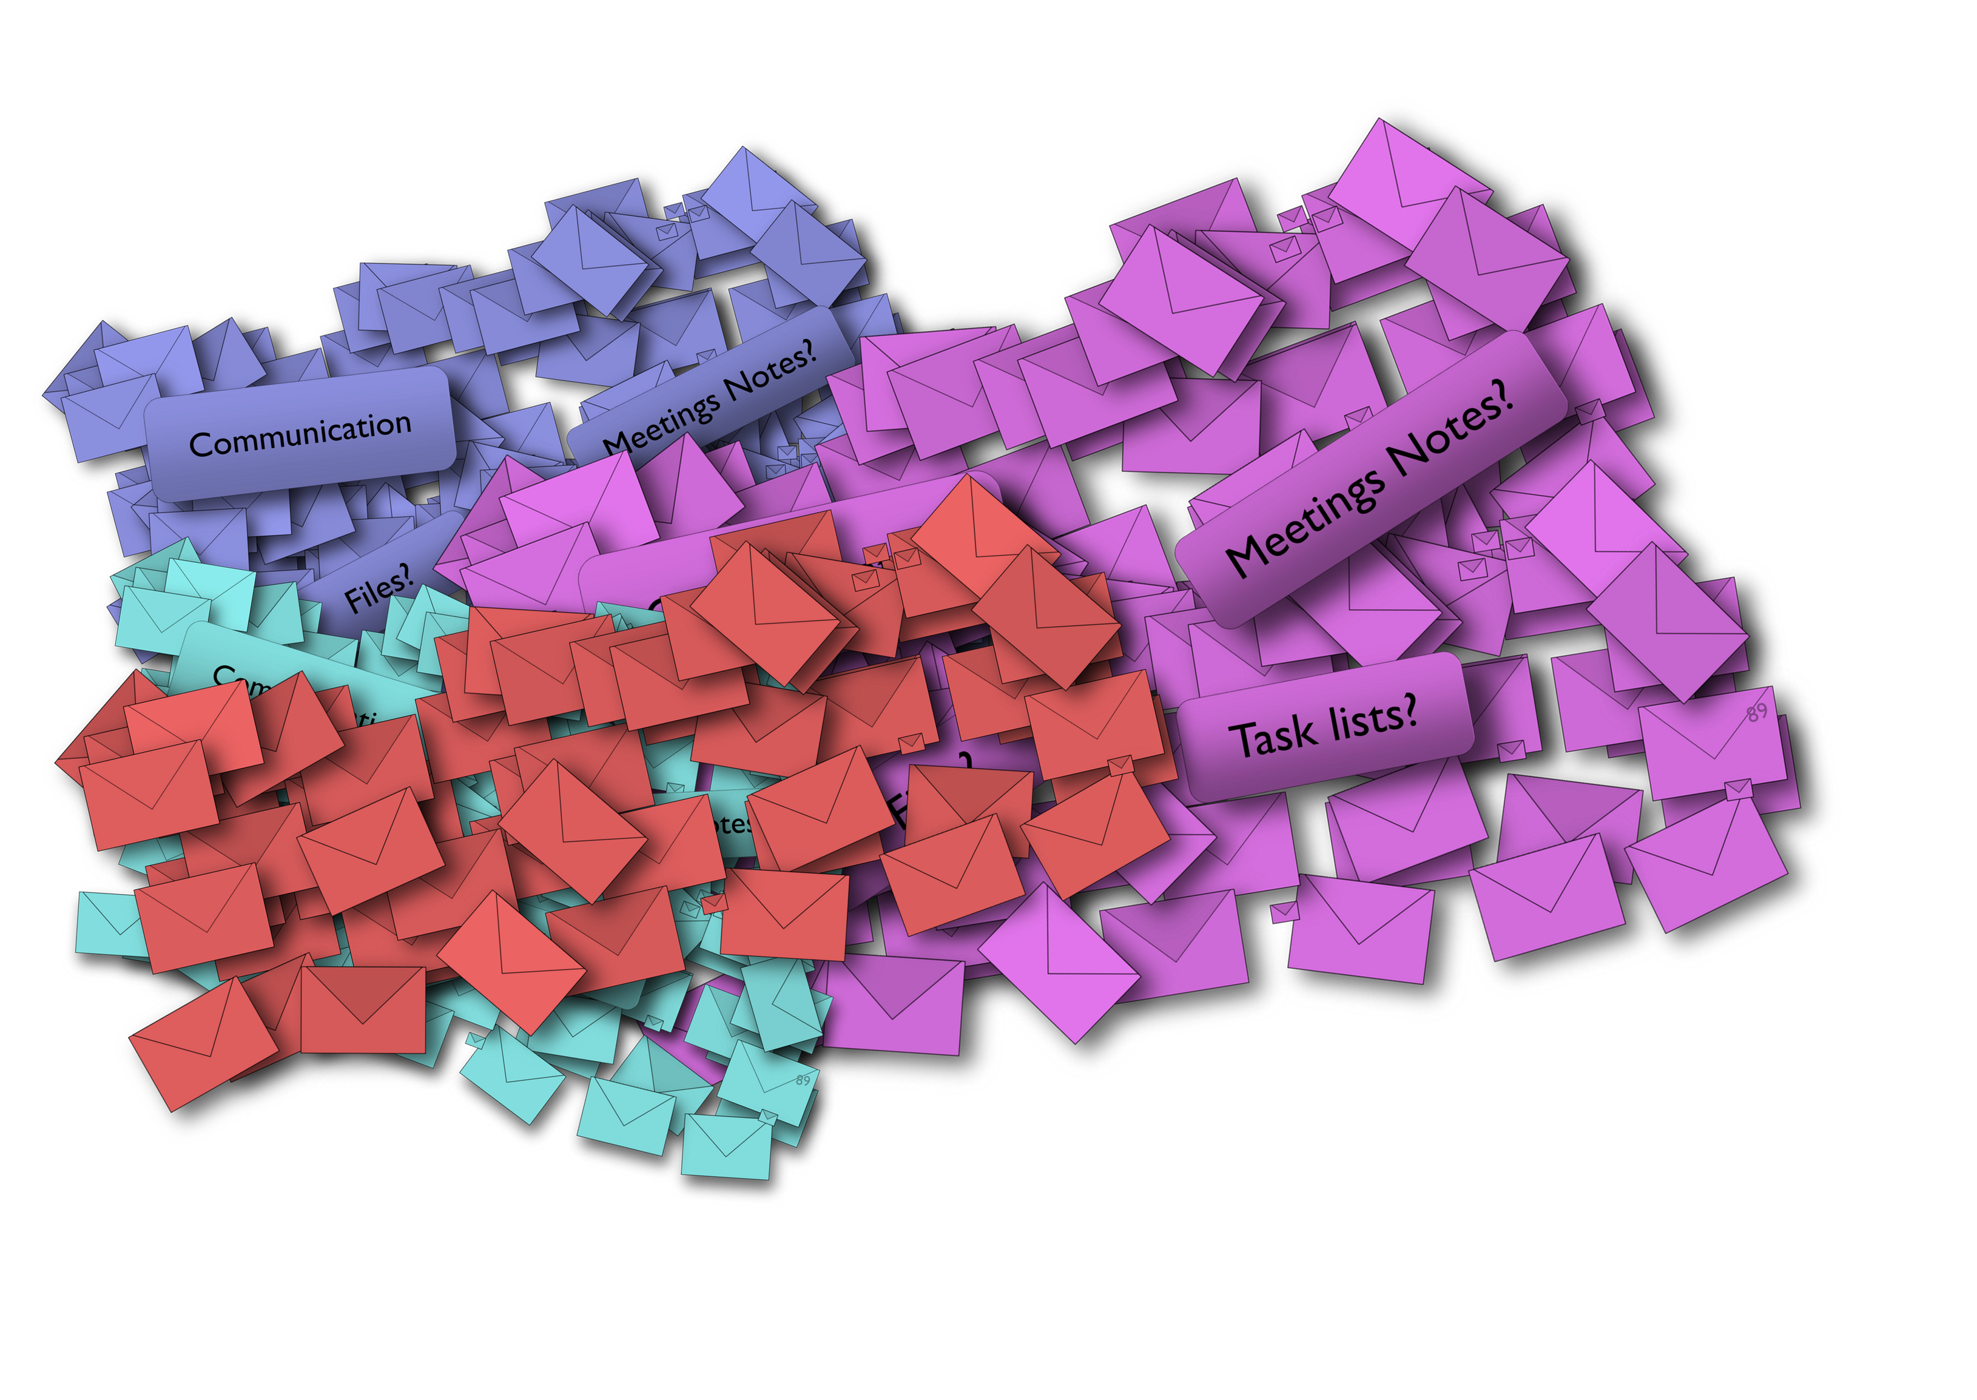
Regular email

Slide 22





Simple Teamwork
Messages
Files
Meetings
Email
Chat
Email
Chat
Meet Now
Planned

Slide 23
Structured work requires a structure!
Team
Channel 1
Tab 1
Tab 2
Channel 2
Tab 1
Tab 2
New Team
General
Posts
Files
Add channels
Product Launch
General
Posts
Files
Planning
Posts
Files
Tasks
Execution
Posts
Files
Reports
Recruitment
General
Posts
VP Finance
Posts
Files
Files
Templates
Resumes
Offer letters
VP Marketing
Posts
Files
Templates
Resumes
Offer letters
Monthly Review
General
Posts
Files
Tasks
Mar 2020
Posts
Files
Apr 2020
Posts
Files
May 2020
Posts
Files
Audit
General
Posts
Files
Branch Audit
Posts
Files
Regional Audit
Files
Reports
Posts
Files
Audit Findings
Posts

Slide 24
Product Launch
General
Planning
Marketing
Event Management
Recruitment
General
Manager, Finance
Python developer
Monthly Review
General
2021 Nov
2021 Dec
2021 Yr rev
Patient Care
General
Rounds
Scheduling
Reports
Procedures

Slide 25



Before
Outlook or Teams
Lobby
Channel Meetings
During
Audio /Video
Screen Sharing
Recording
Chat
Notes
After
Notes
Recording
Whiteboard
Minutes
Chat
Follow up
Files
Files
Polls
Whiteboard
Action Items
Transcript
Collaterals

Slide 26







Contacts
Organization
Business
Personal

Slide 27
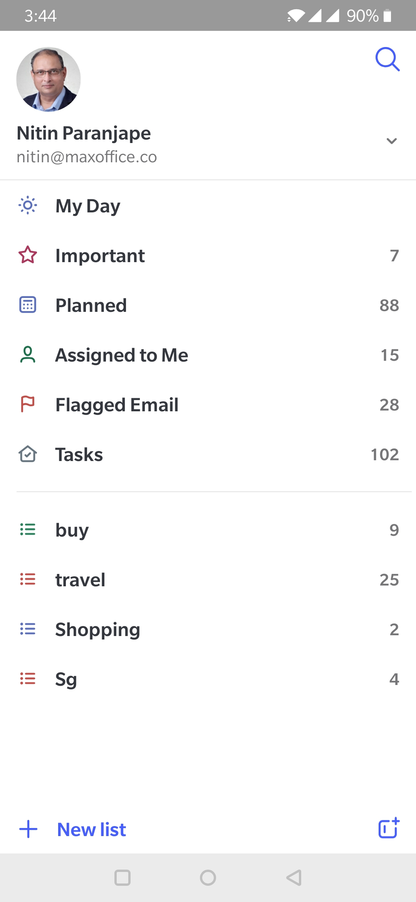



Teamwork
My Work

Slide 28
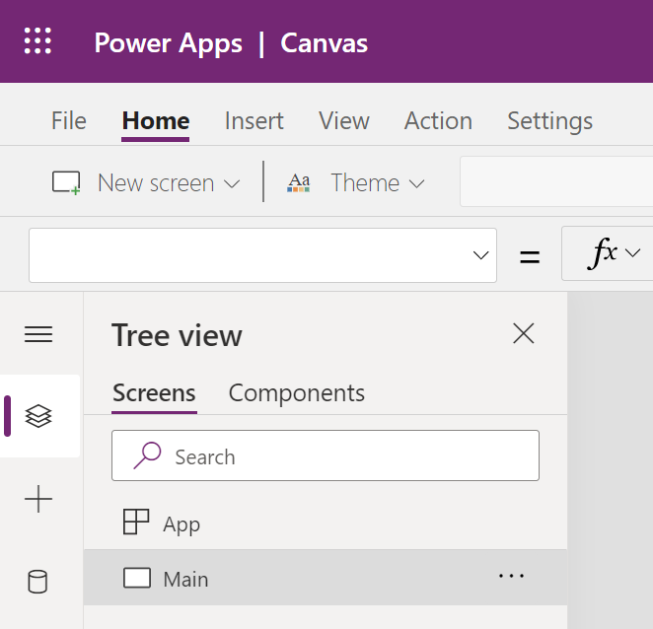
Burger
Waffle
Overflow

Slide 29


Slide 30

Microsoft 365
Create
Store
Communicate
Analyse
Word
Excel
OneDrive
SharePoint
Outlook
Power
BI
Stream
Automate
PowerPoint
OneNote
Execute
Teams
Sway
Forms
To Do
Planner
Yammer
Power
Automate
Power
Apps

Slide 31
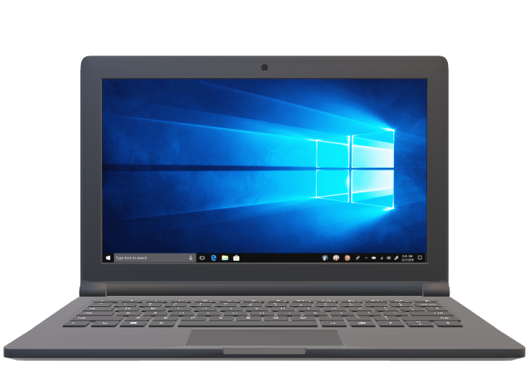














Slide 32
Sharing Links is
more | Efficient
 | Secure
compared to
Sending Attachments

Slide 33
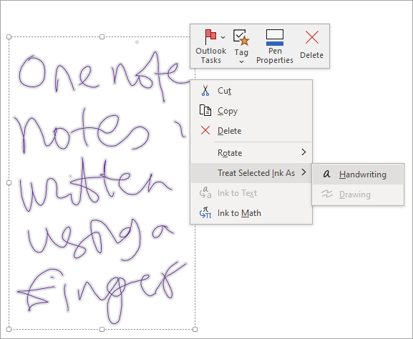

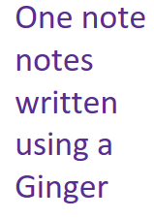

Slide 34
Clean
Get
Analyze

Slide 35
Create List
Add Columns
Share Link
Enter Data
Analyze Data

Slide 36
Adoption Process
Led by
Leaders
Educate
Everyone
Best Practices
Champions
1
2
3
4

Slide 37
Types of work
Work
My Work
Teamwork
I execute
I delegate
Single
Task
Multiple Related Tasks

Slide 38
Explore
Learn
Apply
Standardize
Share

