Slide 1
Text Grouping using DAX

Slide 2
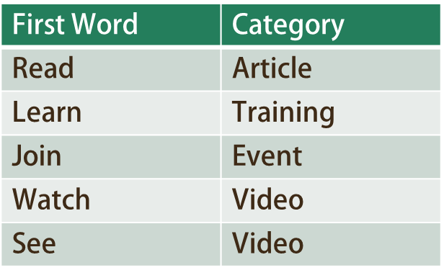
Categorize the posts

Slide 3
Count related rows
Posts[Message]
Count
1
2
1
1

Slide 4
COUNTROWS( RELATEDTABLE(Posts) )
Posts[Message]
Count
1
2
1
1

Slide 5
COUNTROWS( RELATEDTABLE(Posts) )
Posts[Message]
Count
1
2
1
1

