Slide 1
SCAM Part 2
Dr Nitin Paranjape
Efficiency365.com

Slide 2
Survey Results
Thank YOU!
21 responses
80% are using all

Slide 3
Useful Thoughts : Social
Great for talent acquisition
Cross-company communication
Instant knowledge sharing
Usage often stagnates
Needs active management and response
Must have CXO involvement

Slide 4
Social
Instant Communication
Slow Communication
Internal
Yammer, FB for business, Jive, Chatter, etc.
WhatsApp!
External
Web presence
FB, Twitter, Blogs, etc.
Mixed
Employees + External Parties

Slide 5
Useful Thoughts: Mobility
Simple forms
Point of contact activities
Location independence
Understand use of PRESENCE status
Field staff benefits the most
Difficult to deliver great User Experience
Consider delivering read only information (reports)
Faster TAT

Slide 6
Useful Thoughts: Cloud
Reduced cost of infrastructure
Instant upgrades
Increases Bandwidth Cost (how to minimize it?)
Many have got it but not used it!
Natural evolution. Just use it.
Great for start-ups
Regulatory Concerns
fgg ☺

Slide 7
Useful Thoughts: Analytics
Beyond normal reporting
Quick Business Decisions
Talented resources not available
Long term strategy required
Crawl – Walk – Run approach is good
Analyze unstructured data as well
Lot of scope to innovate
fff

Slide 8
Best Thought Jayanti Patel: Mahendra Brothers Exports
Cloud is like a live-in relationship rather than getting married ☺

Slide 9
Analytics

Slide 10
Simple definition
Learn EVERY useful thing from the PAST in order to improve the PRESENT and the FUTURE

Slide 11
The Process
Get data
Clean up
Summarize
Visualize
Understand
Act

Slide 12
Question: Who will do it?
As far as possible END USERS
Keep IT involvement to minimum
Provide tools and applied knowledge
Guide them on how to analyze
Leave them alone

Slide 13
Get data
Ideal format is TABULAR
Use POWER QUERY for data gathering
Use direct connection to Cubes
Use SharePoint lists for Masters
Use reporting database connection for txn data
Rewrite Export to Excel code (Denormalized Recordset)
Minimize / eliminate end user cleanup
NEVER give CSV files. Rename to TXT.

Slide 14
Good Data Checklist
Each column must have a unique heading
No merged cells
Consistent data in each column
One meaning in one column
No horizontal calculations
Data should not be in the headings
No blank rows
NO FORMATTING
Input should not look like Output
Should always grow vertically

Slide 15
Bad Data Handling
Get data
Check it
If bad – send it back
Demand it in good format

Slide 16
Clean Up
Power Query
Flash Fill
Cross Tab Consolidation
Import into Data Model
Create TIME dimension table
Eliminate VLOOKUP, use Relationships
GO TO – Special - Blanks

Slide 17
Quick data audit using Pivot Table

Slide 18
Summarization
Pivot Table
Large data : Power Pivot
Millions of rows
Small file size
Amazing performance
No hardware upgrade required

Slide 19
Visualization for simplifying interpretation
Relook at all visuals and question the usability
Don’t use formatting because boss wants it that way
Understand all available visualizations
Use them correctly
Interpretation can only be done by humans

Slide 20
INTERactivity promotes INTERpretation
Slicers
Power View
Drill Down
Lineage
Multiple Synchronized views
Must work on all devices and form factors

Slide 21
Geographical information must be analyzed geographically!

Slide 22
Delivering Reports
NEVER send by mail
NEVER copy paste as values
Post it on SharePoint
Decide what to show
Enable alerts
Use versioning for backdated reports
Try Power BI – it is FREE

Slide 23
Incentives for Insights

Slide 24
PowerPoint demo
Exceed your OWN expectations…

Slide 25
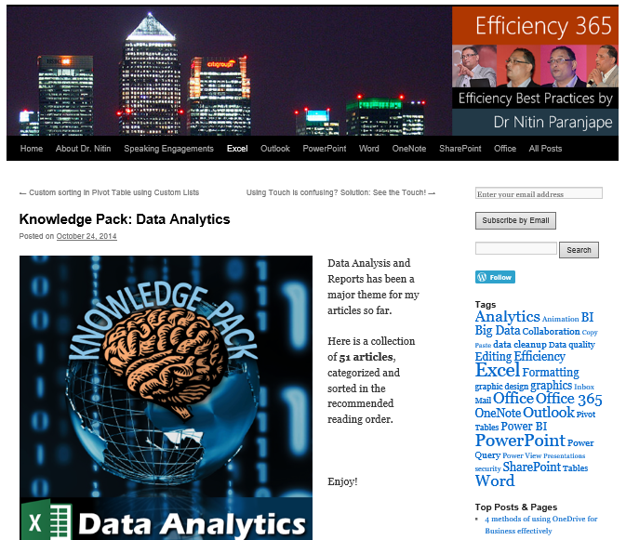
Thank You
Efficiency365.com
@drnitinp
nitin@maxoffice.biz
9820610140
bit.ly/nitincc2015 This session video!

