Slide 1
SMAC: Hype vs. Reality
Dr Nitin Paranjape
Efficiency365.com

Slide 2
My thoughts and ideas
Based upon field interaction
No copy paste
Also based upon past waves of disruption

Slide 3
Technology Success Criteria
Improve / eliminate existing
Enable new and useful
Used

Slide 4
DEMO

Slide 5
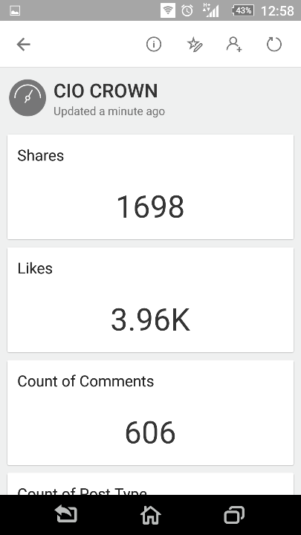
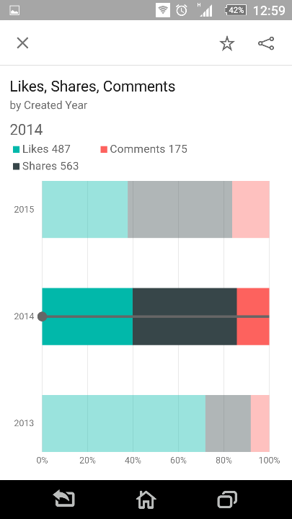
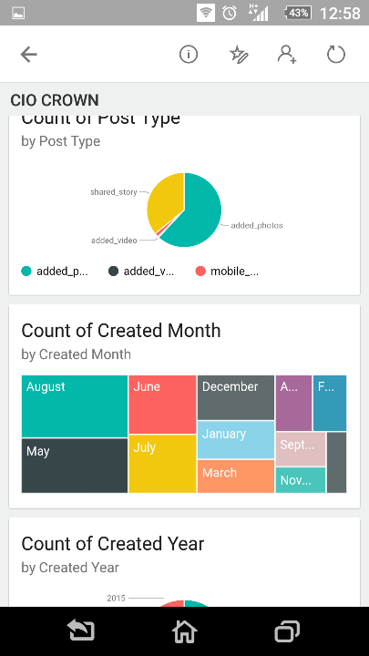

Slide 6
Parties involved
Vendor
Partner
Customer

Slide 7
Beyond control? No Choice?
Social – no
Mobility – yes
Analytics – no
Cloud – yes

Slide 8
Ease of demonstrating business value
Social - ?
Mobility – Good
Analytics – Very High
Cloud - High

Slide 9
Natural Extension?
Social – No
Mobility – No
Analytics – Yes
Cloud - Yes

Slide 10
Cross-Fit
SM – Yes
SA – Yes
SC – ?
MA – ?
MC – Yes
AC – ?

Slide 11
Potential Benefits vs. Actual Benefits
Potential is generic
Actual requires effective utilization
Utilization requires user adoption

Slide 12
Cloud
Cost reduction
Risk Mitigation
Flexibility
Scalability

Slide 13
Mobility
Mobility
Capture at source
New Interaction
Human replacing technology
Crowdsourcing
Faster response time

Slide 14
Analytics
Know more, act better
Know and act faster
Predict and Prepare better
Learn new things in new ways

Slide 15
Social
Ambiguous
Inherent Resistance
Concern about misuse
Confidentiality and Compliance

Slide 16
Overlapping needs and Ambiguity
Announcements – Social, Mobile, Intranet or Email
Discussion about issues – Email, Social or Meetings
Mobile Apps – Browser or Native?
Infrastructure – Response Time, Convenience, Bandwidth

Slide 17
Practical Social Usage Scenarios
Announcements
Emergency Coordination
When you don’t know whom to ask
Highlight achievements
Brainstorming about open issues
Evolving Best Practices
CXO connect
M&A

Slide 18
Unearthing the benefits
Learn features
Document technical benefits
Map to business context
Document Business benefit
Enlist beneficiaries
Quantify benefit

Slide 19
Change Management
What is in it for me?
Jealousy
Competition
Unbelievable Benefits
Top Management Involvement
Endorsement by Power Users

Slide 20
Adoption Strategies
Small Pilots
End user involvement
End user ownership
Visibility
Internal Marketing
Sustenance based approach

Slide 21
User Education
Should cover ALL potential beneficiaries
Need – Solution approach
DO NOT use Feature – Tips and Tricks approach
Include integration across products
Awareness is NOT the same as adoption

Slide 22
From awareness to actual usage
Awareness = Knowing what is possible
Usage = Doing what is possible
Usage requires confidence to practice it in real life situations
Actual practice in a safe environment required

Slide 23
Demo SMAC
FB analytics

Slide 24
Picture abhi baki hai ☺

Slide 25
Your turn!
Fill this survey bit.ly/nitincc
Review and Learnings
Presentation Tomorrow

Slide 26
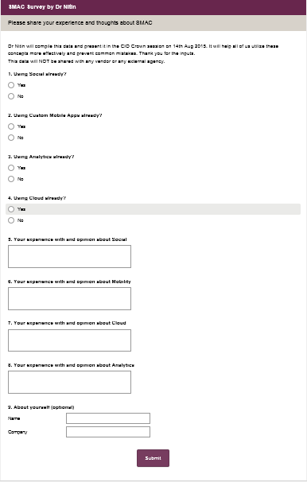

Slide 27
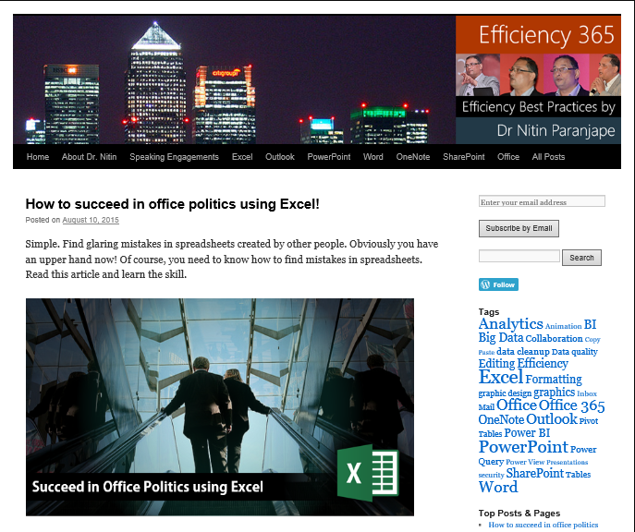
Thank You
Efficiency365.com
@drnitinp
nitin@maxoffice.biz
9820610140

