Slide 1
Artistic Effects in PowerPoint
Dr Nitin Paranjape
http://efficiency365.com

Slide 2
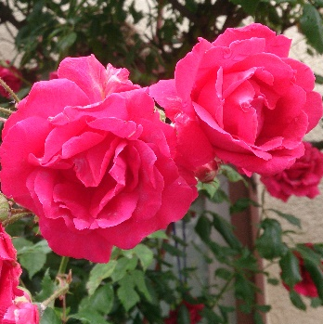
Original
Original

Slide 3
Original
Marker
Default Size 97

Slide 4
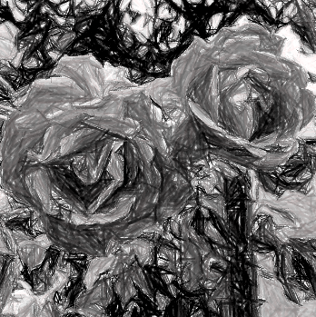
Original
Pencil Grayscale
Default Pencil Size 27
Changed to 6

Slide 5
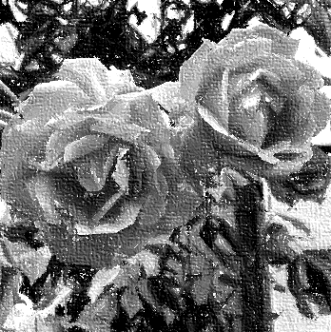
Original
Pencil Sketch
Default Pressure 22
Changed to

Slide 6
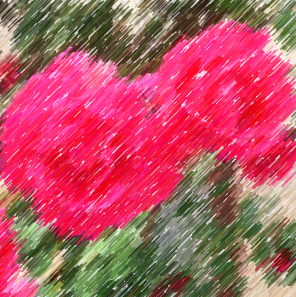
Original
Line Drawing
Default Pencil Size 0
Changed to 10

Slide 7
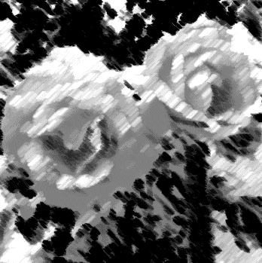
Original
Chalk Sketch
Default Pressure 0
Changed to 1

Slide 8
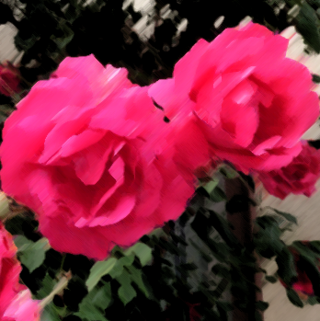
Original
Paint Strokes
Default Intensity 5
Changed to 3

Slide 9
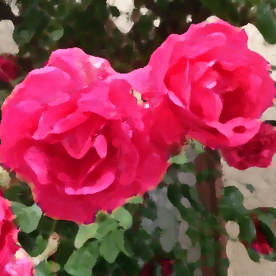
Original
Paint Brush
Default Brush Size 2
Changed to 10

Slide 10
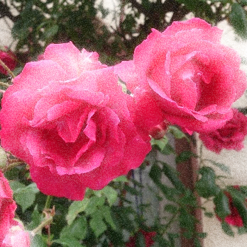
Original
Glow Diffused
Default Intensity 5
Changed to 4

Slide 11
Original
Blur
Default Radius 10
Changed to 6

Slide 12
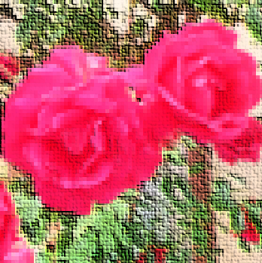
Original
Light Screen
Default Grid Size 4
Changed to 0

Slide 13
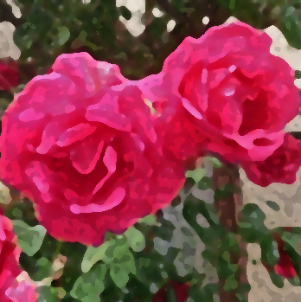
Original
Watercolor Sponge
Default Brush Size 2
Changed to 6

Slide 14
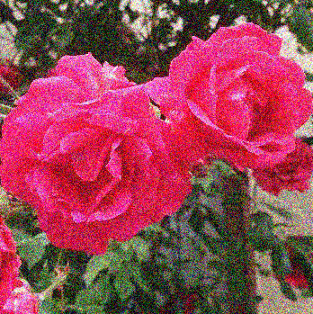
Original
Film Grain
Default Grain Size 40
Changed to 60

Slide 15
Original
Mosaic Bubbles
Default Pressure 14
Changed to 51

Slide 16
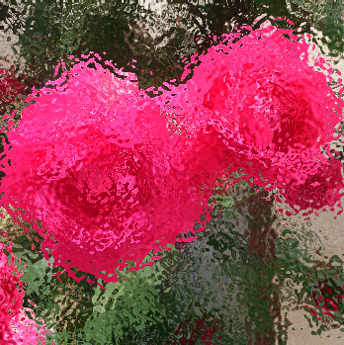
Original
Glass
Default Scaling 34
Changed to 66

Slide 17
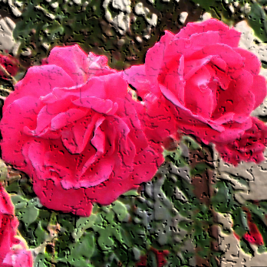
Original
Cement
Default Crack Spacing 24
Changed to 100

Slide 18
Original
Texturizer
Default Scaling 34
Changed to 62

Slide 19
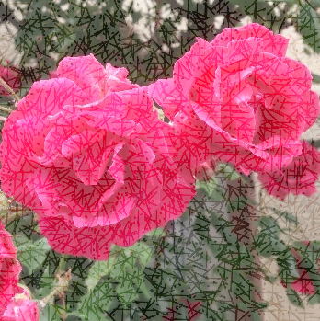
Original
Crisscross Etching
Default Pressure 30
Changed to 60

Slide 20
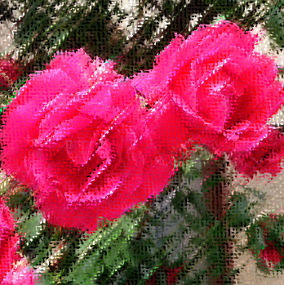
Original
Pastels Smooth
Default Scaling 34
Changed to 65

Slide 21
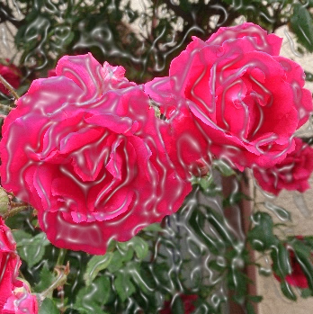
Original
Plastic Wrap
Default Smoothness 5

Slide 22
Original
Cutout
Default No of Shades 2
Changed to 5

Slide 23
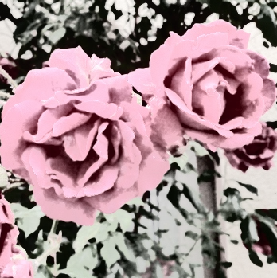
Original
Photocopy
Default Detail 3
Changed to 9

Slide 24
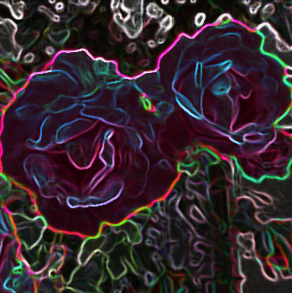
Original
Glow Edges
Default Smoothness 3
Changed to 5

