Slide 1
Instant Transparency to be used with this article

Slide 2
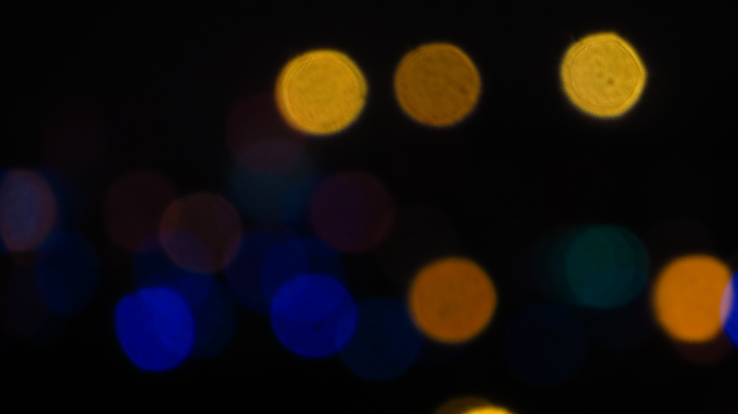
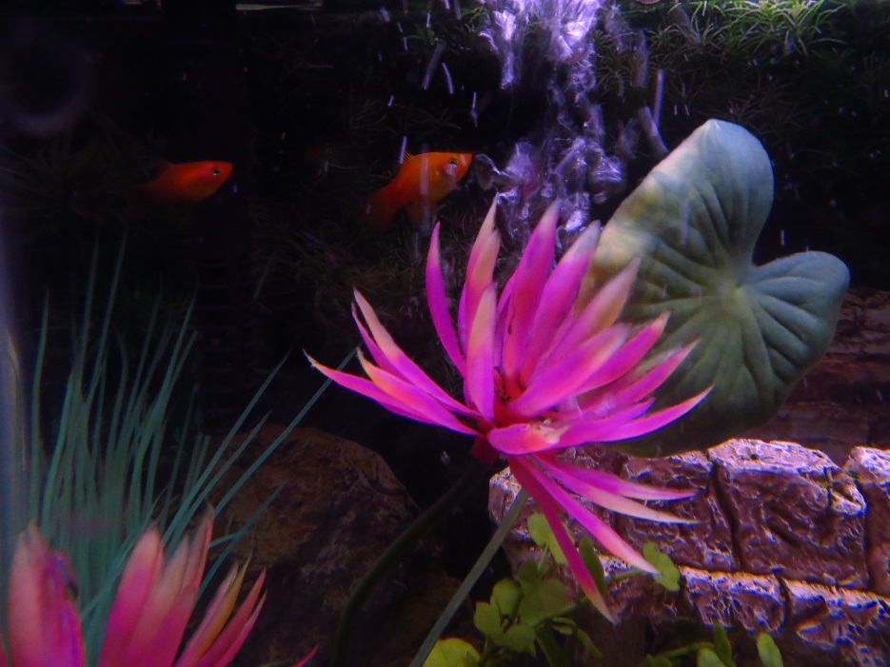
Two images. We want to mix them.

Slide 3
Resize one of the images and capture the mixed version

