Slide 1
Gradients – Part 2 Companion Presentation
Dr Nitin Paranjape
http://Efficiency365.wordpress.com

Slide 2
Linear
Radial
Rectangular
Path

Slide 4
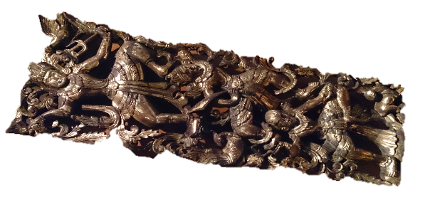
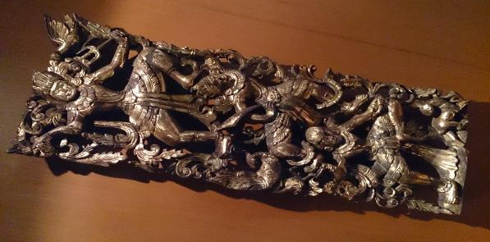

Slide 5
I used this box to push the slide to the right side so that it is near to the gradients options. This helped me capture screenshots of the slide object and the UI

Slide 6
FOCUS
FOCUS

Slide 8
FOCUS
DEMO

Slide 10
Pattern with Gradient

Slide 12
Using Gradients Effectively – Part II

