Slide 1
PowerPoint Animation
Sample no 4
Dr Nitin Paranjape
http://efficiency365.wordpress.com

Slide 2
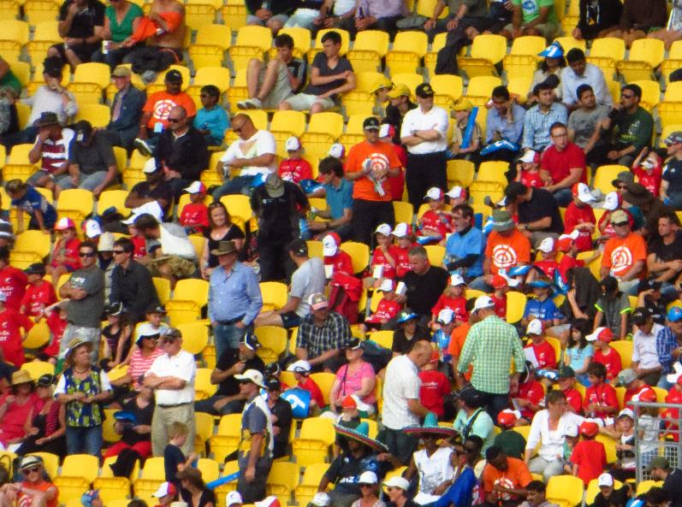
Text, Shapes, Picture and Excel

