Slide 1
PowerPoint Animation Pane
Dr Nitin Paranjape
http://efficiency365.wordpress.com

Slide 2
Read these articles before you continue This is the third part of a series of articles about PowerPoint Animation
Understand PowerPoint animation concepts in 10 minutes
Explore PowerPoint animation in 20 min

Slide 3
Recap
Slides are shown on a trigger – which usually is a click
Default action is Go to next slide
All objects on the slide are shown along with the slide
To control the lifecycle of objects add specific actions
These actions are called Animations By now you must be fully aware of all these animation effects

Slide 4
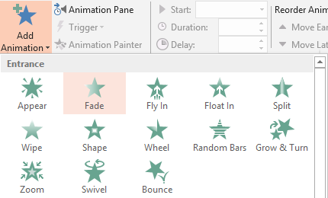
Controlling the animation
Here I am applying Fade effect from Entry Animation
Click to see the effect
Without animation
With Animation
Fade Effect

Slide 5
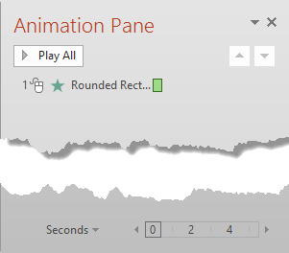
The animation effect can be modified using the Animation Pane
When you have many objects in animation sequence, these names become very confusing.
Therefore, it is a good idea to change these names using Selection Pane
Timeline

Slide 6
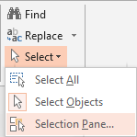
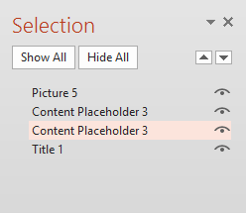
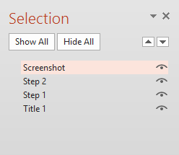
Home tab – Select – Selection Pane Change the name of each object to something which is easy to understand

Slide 7
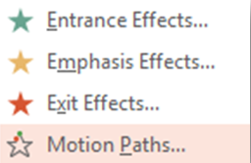
Now the Animation Pane shows the new name. The tool tip shows more details.
Trigger (Click) Sequence Number
Mouse Click
Duration of animation
Type of animation effect

Slide 8
Open the drop-down to view more options

Slide 9
Timing Options
Use Repeat when you want the same action running again and again. For example you want to spin a wheel.
Click to see a spinning wheel.

Slide 10
YOU try this. Spin multiple wheels in ONE click
Select all the wheels and Add Spin Animation
Select all the animation and open the dropdown – choose Timing
Change the Repeat option to – Until end of the slide
Press Shift F5 to run the animation.
Next slide shows the completed animation

Slide 11
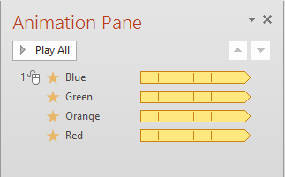
See the Animation Pane sequence. Click to trigger the animation …

Slide 12
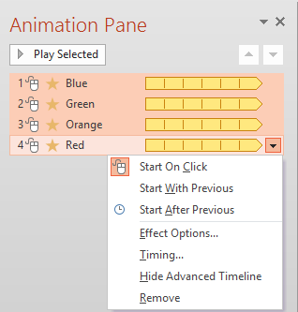
Now change the setting to Start on Click for all four animations and see the difference. Click 4 times ….

Slide 13
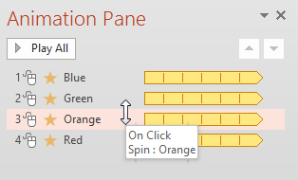
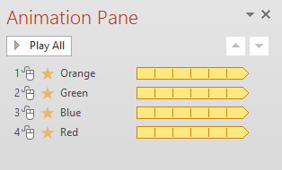
Now change the order of animation. Observe the mouse cursor …

Slide 14
Click 4 times to see the new sequence

Slide 15
Try again to learn more
If you are confused, close this presentation
Do not save
Download it again from the blog site
Start again
Observe existing settings
Tweak them and see the impact

