Slide 1
PowerPoint Animation Part 2 The Car Race
Dr Nitin Paranjape
http://efficiency365.wordpress.com

Slide 2
Read these articles before you continue This is the fourth part of a series of articles about PowerPoint Animation
Understand PowerPoint animation concepts in 10 minutes
Explore PowerPoint animation in 20 min
The Animation Pain (oops… Pane)

Slide 3
Recap
Slides are shown on a trigger – which usually is a click
Actions are of four types
Actions have
Duration
Repetition count
The slide being show itself is the first trigger

Slide 4
Let’s do some car racing

Slide 5
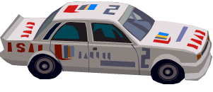
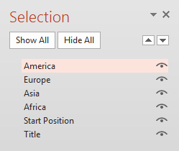
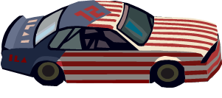
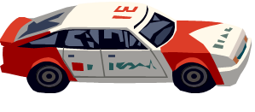
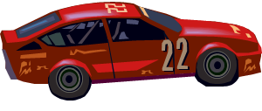
Four cars. Names Changed in Selection Pane.

Slide 6
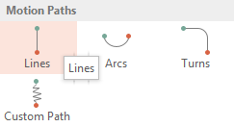
Let us move ONE car using Motion Path
Adjust the ending position. The end position shows the full object only in PowerPoint 2013.
Older versions just show the red arrow. Due to this it is very difficult to adjust ending position precisely.

Slide 7
Click to see the animation. Press Left arrow and Right arrow to view the action many times.

Slide 8
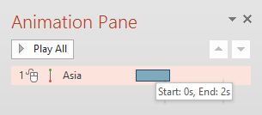
What is happening?
Start
0 Sec
Stop
2 Sec
1 sec
Accelerates slowly
Slows down and stops

Slide 9
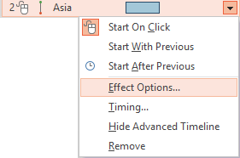
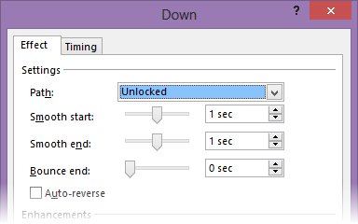
Open Effect options

Slide 10
Understand how Smooth start and Smooth end options work
Start
0 Sec
Smooth Start
Smooth End
Stop
2 Sec
1 sec

Slide 11
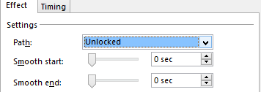
NO Smooth start and NO Smooth end This leads to abrupt movement
Start
0 Sec
Constant Speed Constant Speed Constant Speed
Stop
2 Sec
1 sec

Slide 12
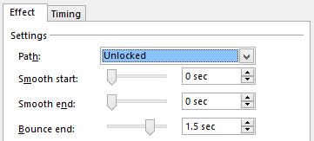
Now some fun. Bounce end for 1.5 seconds
Start
0.0 Sec
Finish the movement in 0.5 seconds
Stop
0.5 sec
0.25 sec
Bounce End means
Settle down
1.5 sec

Slide 13
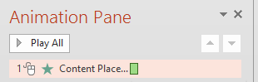
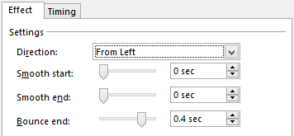
See how Excel data looks more exciting with Bounce End and a little shadow
Duration
0.5 second
Fly in from Left

Slide 14
Now back to the race. Added a finish line. Let us move one car. Car should go beyond the screen. Smooth Start – but no smooth end – we cant see the end now. Click…

Slide 15
All cars should have similar animation.
Animation Painter is like Format Painter
Click on third car.
Double Click Animation Painter.
Then click once on each car to apply the animation

Slide 16
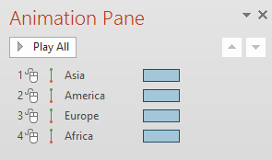
Animation looks like this…
These are trigger numbers.
See the animation pane and correlate with the actual objects.
These are images for illustration purpose. These are not real objects. Try this in the next slide.

Slide 17
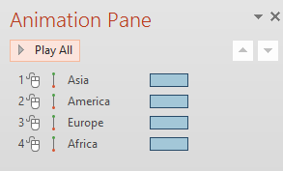
Click and see what happens
All animations are Start on Click. 4 clicks required!
We need all of them to start after the FIRST trigger

Slide 18
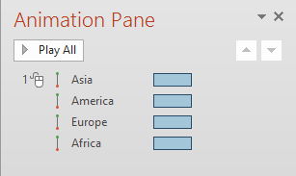
First one is Start on Click and others are Start with Previous. Previous what? Previous “trigger” of course!
Now we have another problem.
Everyone finishes exactly at the same time ☹

Slide 19
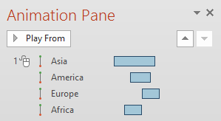
So we will change the duration and starting point of each animation and see what happens.

Slide 20
Now THAT looks like a real race!

Slide 21
Learn from the animation in this presentation
Look at each slide
Keep the Selection Pan and Animation Pane open
Understand how things are done
Click on an animation and see the preview This way you can see the impact of a particular animation without running the entire slide
If you have any queries, post as comments

